Slide 1

MODULE 4
SPUR GEARS AND GEAR TRAINS

Slide 2
Syllabus:
Module – 4
Spur Gears: Gear terminology, law of gearing, path of contact, arc of contact, contact ratio of spur gear. Interference in involute gears, methods of avoiding interference, back lash, condition for minimum number of teeth to avoid interference, expressions for arc of contact and path of contact
Gear Trains: Simple gear trains, compound gear trains. Epicyclic gear trains: a Algebraic and tabular methods of finding velocity ratio of epicyclic gear trains, torque calculation in epicyclic gear trains.
Duration: 10 Hours

Slide 3
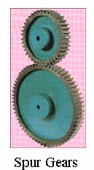
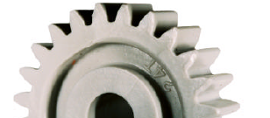
GEARS
Gears are toothed wheels used to transmit motion or power (mechanical energy) accurately, in the form of rotational movement from one shaft to another preferably, if centre distance between the two shafts is small.

Slide 4
Power transmission systems
Belt/Rope Drives - Large center distance of the shafts
Chain Drives - Medium center distance of the shafts
Gear Drives - Small center distance of the shafts

Slide 5
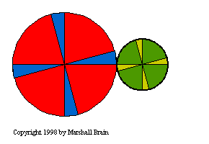
Friction Discs

Slide 6
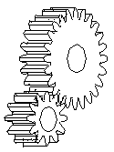
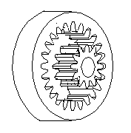
Classification
Gears may be classified according to the relative position of the axes of revolution. The axes may be parallel, intersecting and neither parallel nor intersecting.
1. Gears for connecting parallel shafts
Spur Gears: External contact Internal contact

Slide 7
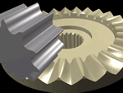
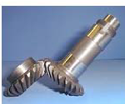
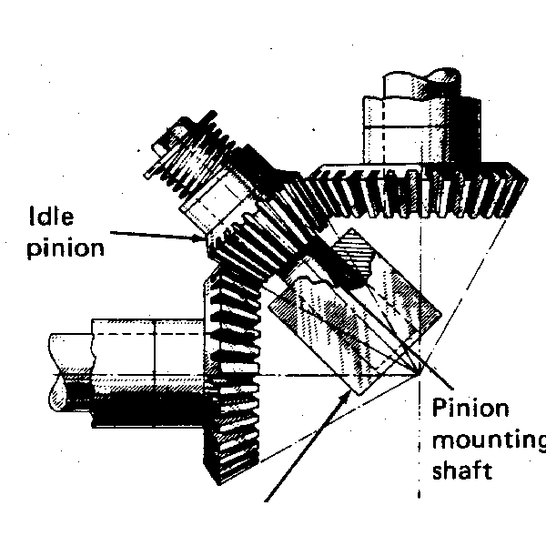
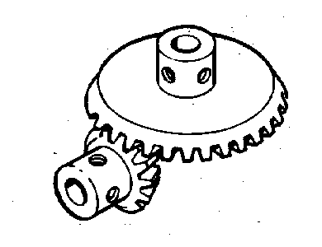
2. Gears for connecting intersecting shafts – Bevel Gears

Slide 8
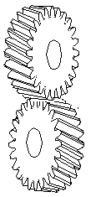
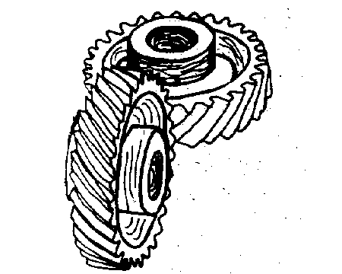
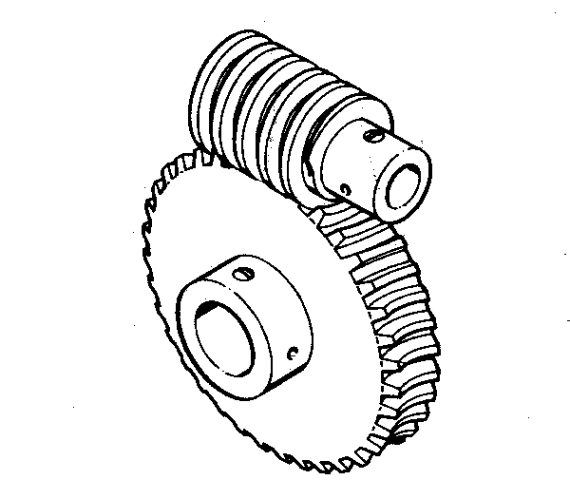
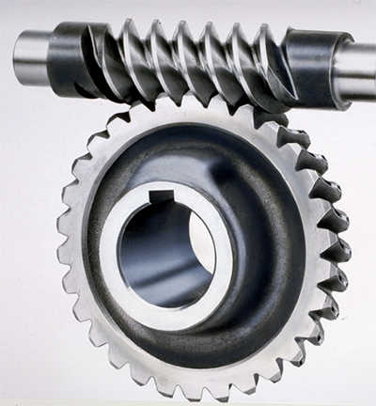
3. Gears for neither parallel nor intersecting shafts.
Crossed-helical gears
Worm & Worm Wheel

Slide 9




Spur Gear

Slide 10
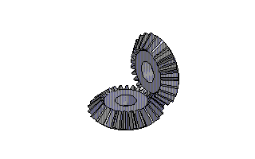
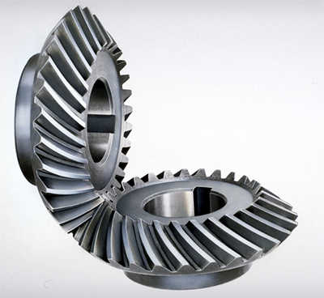
Bevel gears
Straight bevel gears
Spiral bevel gears

Slide 11
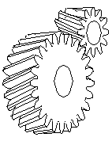

Helical gears
Parallel Helical gears Heringbone gears
(Double Helical gears)

Slide 12
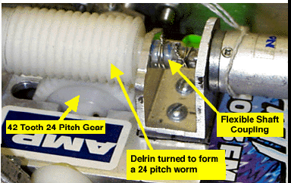
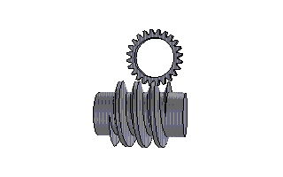
Worm and Worm Wheel

Slide 13
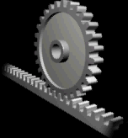
Rack and Pinion

Slide 14
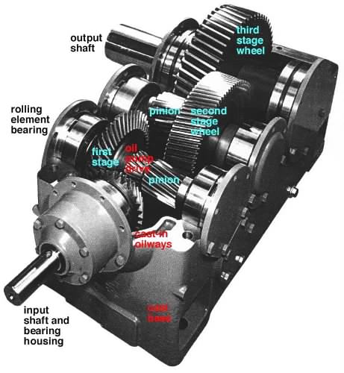
Gear Box

Slide 15
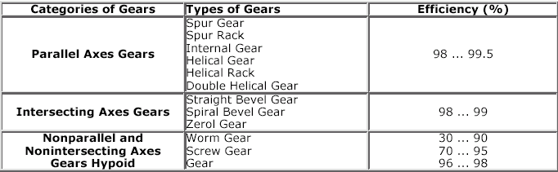
Classification:
According to the relative position of the axes of shafts on which the gears are mounted:

Slide 16
      2. According to the peripheral velocity of gears:
        Low velocity gears (<3 m/s)
        Medium velocity gears (3<15 >m/s)
        High velocity gears(>15 m/s)
      3. According to the position of teeth on gear surface:
Straight teeth – Ex: spur gear
Inclined teeth – Ex: helical gear
Curved teeth – Ex: spiral gear
4. According to the type of gearing:
Internal gearing: gears mesh internally and they rotate in same direction.
External gearing: gears mesh externally and they rotate in opposite direction.

Slide 17
Spur gears:
Gears whose axes are parallel and whose teeth are parallel to center line of the gears are called spur gears.
Terminology:

Slide 18
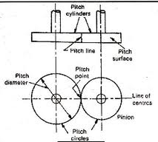
Pitch Circle:
An imaginary circle which passes through the pitch point having its centre
at the axis of the gear, upon which all calculations are made.
Pitch Surface:
it is the surface of the pitch cylinder.
Pitch Point :
The point of contact of two pitch circles is known as the Pitch point.
Line of Centers:
A line through the centers of rotation of a pair of mating gears is the line of centers.
Pitch Diameter:
it is the diameter of the pitch circle.
Pitch Cylinders:
Pitch cylinders of a pair of gears in mesh are the imaginary friction cylinders, which by pure rolling together, transmit the same motion as the pair of gears.

Slide 19
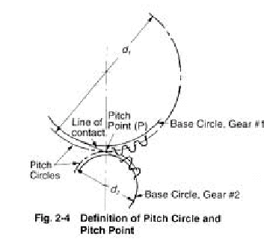
Pinion:
It is the smaller and usually the driving gear of a pair of mated
Circular Pitch:
it is the distance measured along the circumference of the pitch circle from a point on one tooth to the correspond­ing point on the adjacent tooth
Pitch Line:
It is a part of the pitch circle of a rack and is a Straight line
Rack:
It is a part of a gear while of infinite diameter

Slide 20
Diametric Pitch
It is the number of teeth per unit length for Pitch circle diameter in inches
Module (m):
it is the ratio of the pitch diameter to the number Of teeth. The term is used in S.I. units in place of diametric pitch.

Slide 21
Gear Ratio (G):
It is the ratio of the number of teeth on the gear to that on the pinion.
Also,
T = number of teeth on the gear,
t = number of teeth on the pinion.
Velocity Ratio (VR):
The velocity ratio is defined as the ratio of Angular velocity of the follower to the angular velocity of the driving Gear.
Let
Where
d = pitch diameter
T = number of teeth
W = angular velocity (rad/s)
N = angular velocity (rpm)
Subscript 1 = driver, 2 = follower
VR = angular velocity of follower
Angular velocity of driver

Slide 22
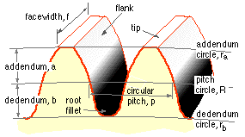

Clearance
Radial difference between the addendum and the Dedendum of a tooth. Thus, Addendum circle diameter = d + 2m
Dedendum circle diameter = d - 2 x 1.157 m
Clearance = 1.157 m - m = 0.157m
Dedendum
It is the radial depth of a tooth below the pitch circle.
Its standard value is 1.157 m.
Dedendum or Root Circle
It is a circle passing through the roots of the teeth
Addendum
It is the radial height of a tooth above the pitch circle.
Its standard value is one module.
Addendum Circle
It is a circle passing through the tips of the teeth

Slide 23
Backlash
It is the difference between the space width and the Tooth thickness along the pitch circle.
Backlash = Space width - Tooth thickness
Working Depth of Teeth
The maximum depth to which a tooth Penetrates into the tooth space of the mating gear is the working Depth of teeth.
Working depth = Sum of addendums of the two gears.
Tooth Thickness
It is the thickness of the tooth measured along The pitch circle.
Full Depth of Teeth
It is the total radial depth of the tooth space.
Full depth = Addendum + Dedendum
Space Width
It is the width of the tooth space along the pitch circle.

Slide 24
Top Land
It is the surface of the top of the tooth.
Face Width
The length of the tooth parallel to the gear axis is the Face width.
Fillet
It is the curved portion of the tooth flank at the root circle.
Flank
Tooth surface between the pitch circle and the bottom land Including fillet.
Bottom Land
The surface of the bottom of the tooth between the adjacent fillets.
Face Tooth
surface between the pitch circle and the top land.

Slide 25
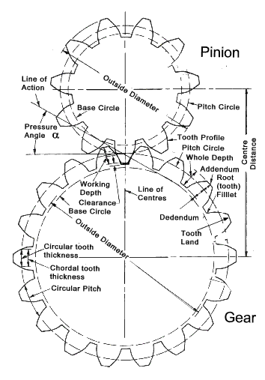
Line of Action or Pressure Line
The force, which the driving tooth exerts on the driven tooth, is along a line from the pitch point to the point of contact of the two teeth. This line is also the common normal at the point of contact of the mating gears and is known as the line of action or the pressure line.
Pressure Angle or Angle of Obliquity (cp)
The angle between the pressure line and the common tangent to the pitch circles is known as the pressure angle or the angle of obliquity
For more power transmission and lesser pressure on the beams, pressure angle must be kept small. Standard pressure angles are 20° and 25°. Gears with 14.5° pressure angles have become almost obsolete

Slide 26
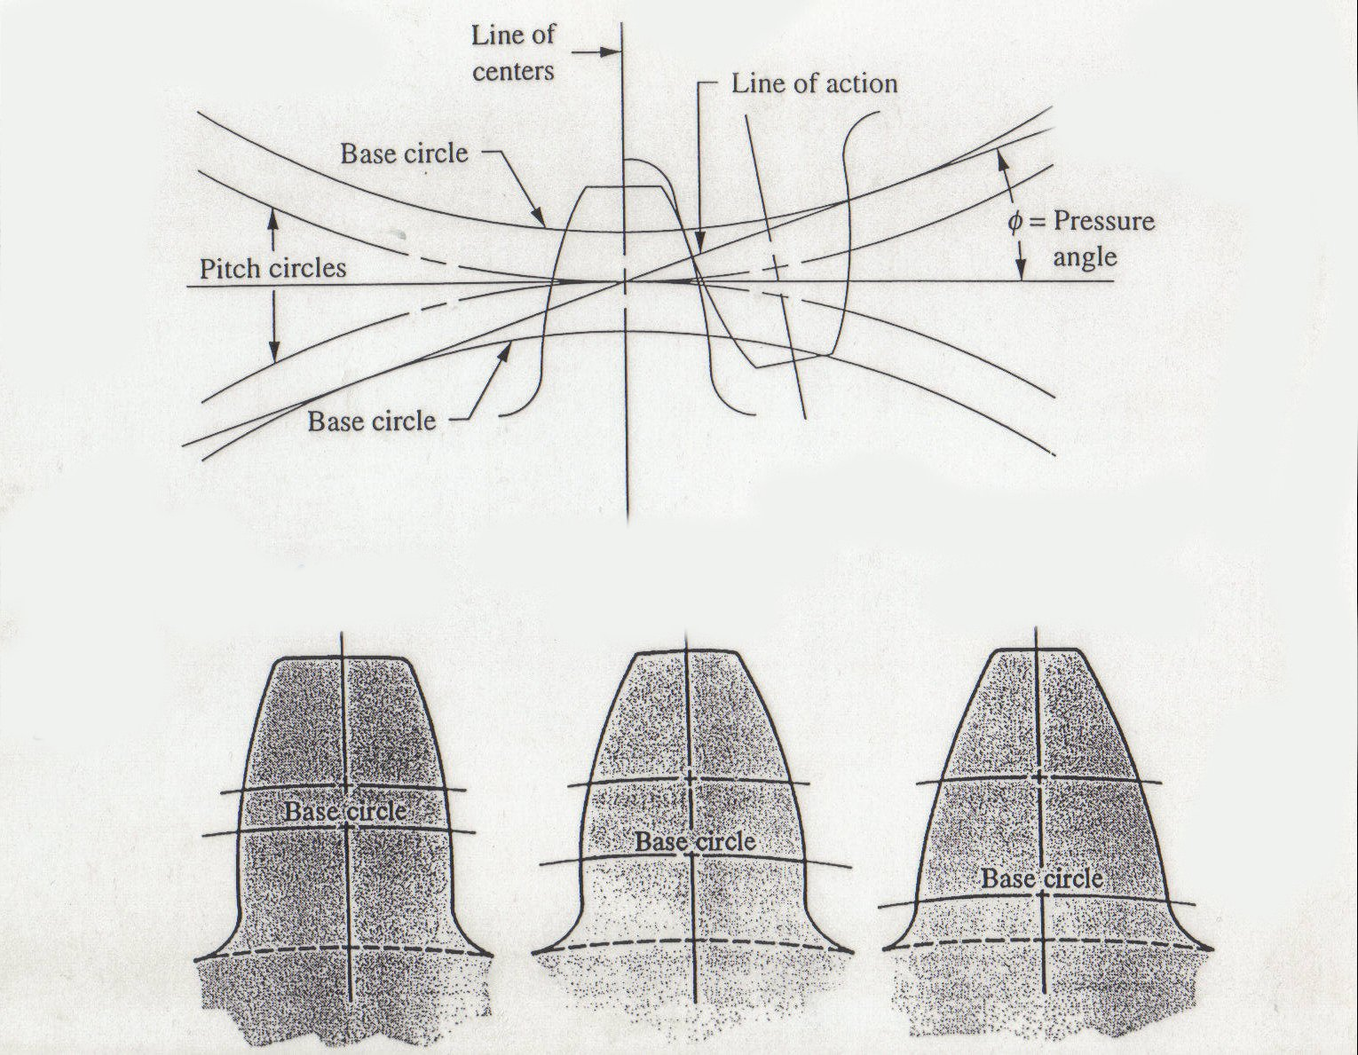
Pressure Angle
Force perpendicular at φ
Φ = 14.5˚
Φ = 20˚
Φ = 25˚

Slide 27
Angle of Action
It is the angle turned by a gear from e beginning of engagement to the end of engagement of a pair of teeth, i.e. the angle turned by arcs of contact of respective gear wheels
Similarly, angle of approach and angle of recess can be defined.
The angle will have different values for the driving and the driven gears.
Contact Ratio
It is the angle of action divided by the pitch angle.

Slide 28
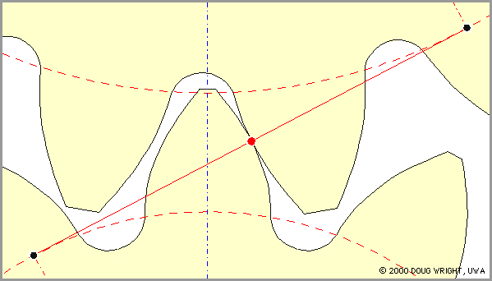

Slide 29

Involute teeth

Slide 30

Cycloidal teeth

Slide 31
Profile:
The curve forming the face and the flank is called profile
Features | Involute Profile | Cycloidal Profile
Definition | Locus of a point on a straight line which rolls without slipping on the circumference of circle (or if the curve is involute in nature then teeth is called involute teeth) | Locus of a point on a circle which rolls without slipping on the circumference of circle (or if the curve is involute in nature then teeth is called involute teeth)
Figure
Pressure angle | Constant thought the engagement. | Varies from commencement to end

Slide 32
Ease of manufacture | Easy to manufacture (because curve is single curve) | Difficult to manufacture (because curve is not single curve)
Centre distance | Do not require exact centre distance (for angular velocity) | Require exact centre distance (for angular velocity)
Interference | May occur | No Interference
Strength | Less (because radial flank) | More (because spreading flanks)

Slide 33
Wear | More | Less
Running | Smooth | Less smooth
Basic form | Constant for all gears | Variable depending upon gear ratio
Path of contact | Straight line | Curve

Slide 34
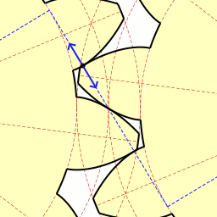
LAW OF GEARING
For constant angular velocity ratio of the two gears, the common normal at the point of contact of the two mating teeth must pass through the pitch point.
A point C on the tooth profile of gear 1 is in contact with a point D on the tooth profile of gear 2. The two curves in contact at point C or D must have a common normal at the point. Let it be n - n.

Slide 35
Let
= instantaneous angular velocity of gear 1 (clockwise)
= instantaneous angular velocity of gear 2 (counter-clockwise)
= linear velocity of C
= linear velocity of D

Slide 36
Then
= . A C in a direction perpendicular to A C or at an angle a to n - n
= . BD in a direction perpendicular to BD or at an angle p to n - n
Now, if the curved surfaces of the teeth of two gears are to remain in contact, one surface may slide relative to the other along the common tangent t - t. The relative motion between the surfaces along the common normal n-n must be zero to avoid the separation, or the penetration of the two teeth into each other.

Slide 37
Component of Vc along n - n = Vc cos
Component of v d along n - n = v_{d} cos
Relative motion along n - n = v_{c} cos - v_{d} cos
Draw perpendiculars AE and BF on n - n from points A and B respectively
Angle CAE =
Angle DBF =

Slide 38
For proper contact,
Relative motion along n - n = v_{c} cos - v_{d} cos = 0

Slide 39
VELOCITY OF SLIDING
if the curved surfaces of the two teeth of the gears 1 and 2 are to remain in contact, one can have a sliding motion relative to the other along the common gent t - t at C or D
Component of Vc along t-t = Vc sin
Component of v d along t-t = v_{d} sin
Relative motion along t-t = v_{c} sin - v_{d} sin

Slide 40
Velocity of sliding = v_{c} sin - v_{d} sin
Since PC=PD
= (Sum of the angular velocity)*(distance between the pitch point & the point of contact)

Slide 41
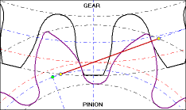
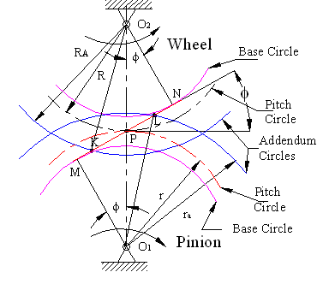
Path of contact
It is the locus of point of contact of two mating teeth from the beginning of the engagement to the end of the engagement.
Path of approach:
It is the portion of path of contact from the beginning of the engagement to the pitch point.
Path of recess:
It is the portion of path of contact from pitch point to the end of engagement.
As shown in the fig. MN is the common tangent at to the base circle. It is equal to the common normal at the point of contact of two teeth. The addendum circle cuts the common tangent MN at point E & F. In other words contact of teeth begins at E & ends at F.

Slide 44
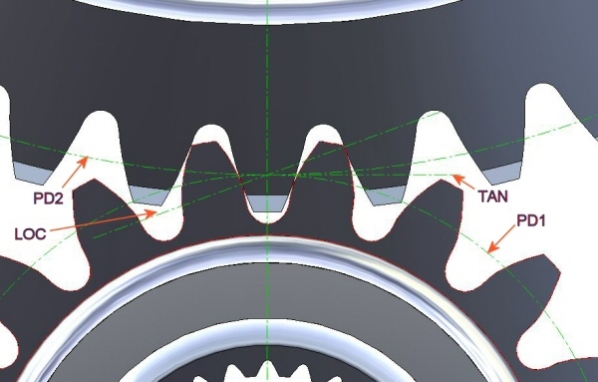

Slide 45
Let,
O₁P = Pitch circle radius of gear = R
O₁E = Addendum circle radius of gear = R_{A}
O₁N = Base circle radius of gear = O₁P cos = R cos
O₂P = Pitch circle radius of pinion = r
O₂E = Addendum circle radius of pinion = r_{A}
O₂N = Base circle radius of pinion = O₂P cos = r cos
= Pressure angle
Length of path of contact = EF = EP + PF…(1)
Where,
EP = Path of approach
PF = Path of recess
Path of approach = EP = EN – PN ………(2)
From triangle O₁PN,
PN = O₁P sin = R sin
Join O₁ to E and from triangle O₁EN,
Substituting the values of PN & EN in equation (2)
Path of approach

Slide 46
Path of recess = PF = MF – MP …………………(4)
From triangle O₂MP,
PN = O₂P sin = r sin
Join O₁ to E and from triangle O₂MF,
Substituting the values of MP & MF in equation (4)
Path of recess
Substituting the values of EP & PF in equation (1), we get
Path of contact
If the driver & driven have equal number of teeth, then the diameter of the driver & driven gears are same. Therefore for equal gears, the equation (6) becomes,

Slide 47
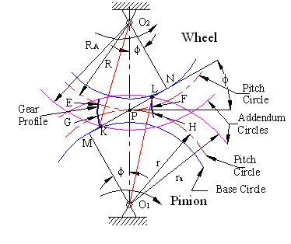
Arc of contact
It is the locus of point on the pitch circle of two mating teeth from the beginning of the engagement to the end of the engagement. In Figure, the arc of contact is EPF or GPH.
Arc of approach:
It is the portion of arc of contact from the beginning of the engagement to the pitch point.
Arc of recess:
It is the portion of arc of contact from pitch point to the end of engagement.
Arc of contact = length of path of contact/ cos ……(8)

Slide 48
Contact ratio
Ratio of angle of action to the pitch angle OR Average number of pairs of teeth which are in contact.
= Angle Of Action
Contact ratio = CR =
= Angle Of Approach
length of path of contact
= ---------------------------------------
Base pitch
= Angle Of Recess
= pitch Angle
length of path of contact
= ---------------------------------------
length of arc of contact
= ---------------------------------------
length of arc of contact
= ---------------------------------------
Circular pitch

Slide 49
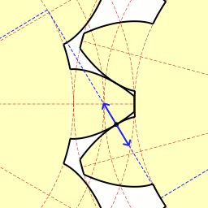
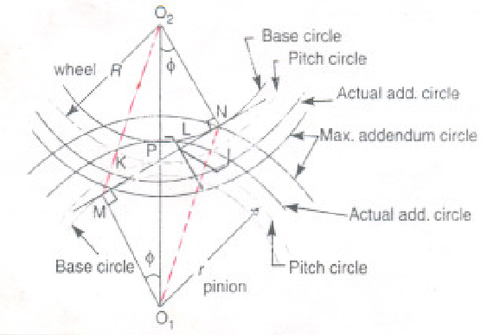
Interference in involutes gears
The phenomenon when the tip of tooth undercuts the root of its mating gear is known as interference OR contact of portion of the two tooth profiles which are not conjugate is called interference.
If the radius of the addendum circle of the pinion is increased to O₁N, the point of contact L will move
When the axis is further increased, the point of contact L will be on the inside of the base circle of the wheel & not on the involute profile of the tooth on the wheel.
Similarly if the radius of the addendum circle of the wheel increases beyond the O₂M, then the tip of the tooth on the wheel will cause interference with the pinion
Points M & N are called interference points

Slide 50
Methods to avoid interference & its effects
Under cutting
Increasing the centre distance
By tooth correction
Height of the teeth may be reduced

Slide 51
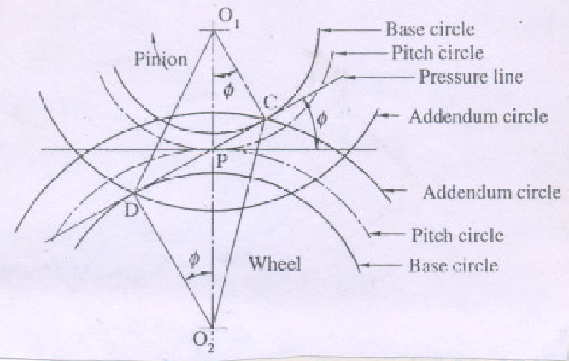
Minimum number of teeth required to avoid interference
Pinion turns counter-clockwise & drives the gear
CD = common tangent
C & D interference points
If the path of contact does not extend beyond either of these points, interference is avoided
O₁D = limiting value of addendum circle radius of pinion
O₂C = limiting value of addendum circle radius of gear
Each addendum circle radius is compared with its limiting value to determine whether there will be a interference
Interference likely to occur on pinion than on gear, and in this case, the critical radius is O₂C, which limits the number of teeth on pinion

Slide 52
O₁P = pitch circle radius of pinion = r = mt/2
O₂P = pitch circle radius of gear = R = mT/2
O₂D = Base circle radius of gear = R_{b}
O₂C = addendum circle radius gear = R_{a}
T = Number of teeth on gear
t = Number of teeth on pinion
a_{w} = addendum constant of gear
a_{p} = addendum constant of pinion
a_{w}m = addendum of gear
a_{p}m = addendum of pinion
G = gear ratio = T/t
From the right angle triangle O₂CD,
O₂C² = O₂D² + CD² = O₂D² + (CP+PD)²
= O₂D² + (O₁P sin + 0₂P sin )²
R²_{a} = R²_{b} + (r sin + R sin )²
= (R cos )² + (r + R)² sin²
= R² cos² + r² sin² + R² sin² + 2 r R sin²
= R² (cos² + sin² ) + r² sin² + 2 r R sin²
= R² + r² sin² + 2 r R sin²

Slide 53
Minimum number of teeth,
We know that,
Addendum of Gear = a_{w}m = R_{a} -R
GEAR RATIO ,G= N1/N2 = R/r = T/t
Number of teeth on gear to avoid interference is,

Slide 54
Number of teeth on the pinion = t = T/G
If number of teeth on the pinion “t” is same as the number of teeth on gear “T”, then the gear ratio G is equal to one.
then equation (4) becomes,

Slide 55
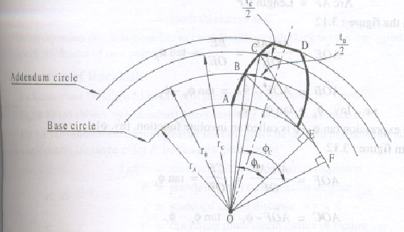
Involutometry
Study of the geometry of involute is called involutometry
Let B & C be two points on the involute
Normal from point B & C are tangent to the base circle
Let,
r_{A} = base circle radius
r_{B}= radius of point B on the involute
r_{C}= radius of point C on the involute
= pressure angle for point B
= pressure angle for point C
t_{B}= arc tooth thickness at B
t_{C}= arc tooth thickness at C

Slide 56
From triangle OBE,
From triangle OCF,
Equating (1) & (2)
From The Geometry (By the properties of the involute)
Arc AE = Length BE
Arc AF = Length CF
Now from fig.,
Angle AOE = Arc AE/OE = BE/OE = tan

Slide 57
Now from fig.,
Angle AOF = Arc AF/OF = CF/OF = tan
From fig., for point B,
S=rθ
S is tB
r is rB
Similarly for point C,
Equating (6) & (7)

Slide 58
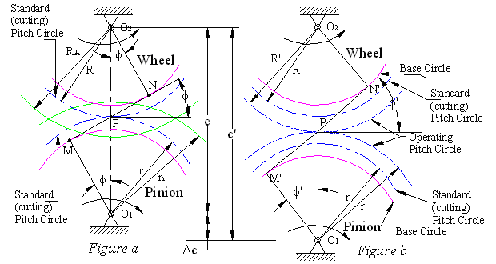
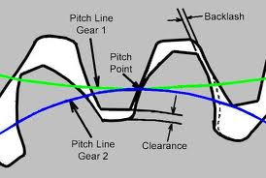
Backlash
It is the difference between the thickness of the tooth & the width of the tooth space in which it meshes.
Backlash must be allowed to prevent jamming of the teeth
Back lash = space width – tooth thickness

Slide 59
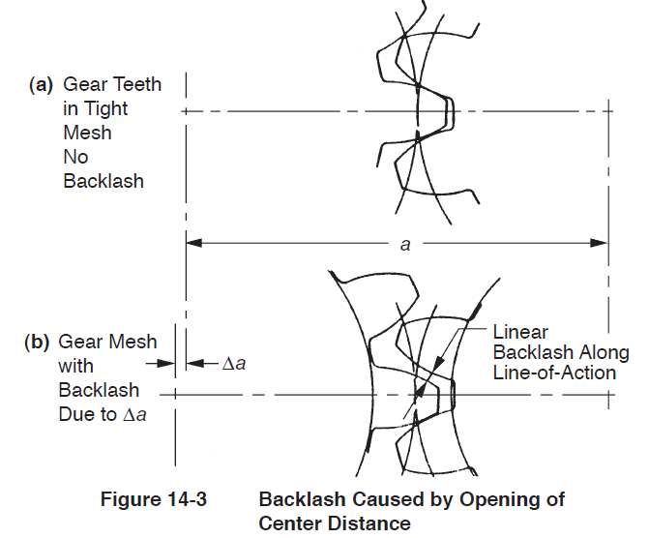

Slide 60
Let, P’ be the new pitch point
r = standard pitch circle radius of pinion
R= standard pitch circle radius of gear
c = standard centre distance = R + r
r’ = operating pitch circle radius of pinion
R’ = operating pitch circle radius of gear
c’ = operating centre distance = R’ + r’
= standard pressure angle
= operating pressure angle
h = tooth thickness of pinion on standard pitch circle =p/2
h’ = tooth thickness of pinion on operating pitch circle
H = tooth thickness of gear on standard pitch circle =p/2
H’ = tooth thickness of gear on operating pitch circle
p = standard circular pitch =
p’ = operating circular pitch =
= change in centre distance
B = backlash
T = number of teeth on gear
t = number of teeth on pinion
Δ_{c}

Slide 61
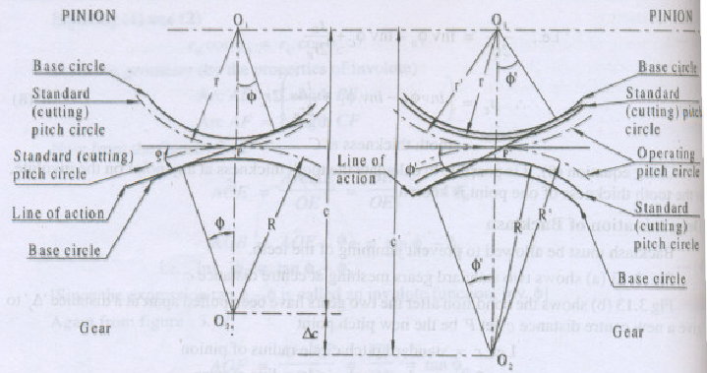
We know,
On the operating pitch circle,
Operating pitch = sum of the tooth thickness + backlash
i.e. p’ = h’ + H’ + B ………………………….(1)
By involutometry,
Since H=h=P/2

Slide 62
Substituting The Values of H’ & h’ inn equation (1),

Slide 63
Problems
A spur gear of 20⁰ pressure angle running at 200 rpm drives another gear at a speed of 100 rpm. The centre distance between the two gears is 300 mm & module is 10 mm. Standard addendum = 1m. Determine:
  Pitch circle radius of pinion
  Pitch circle radius of gear
  No. of teeth on gear
  No. of teeth on pinion
  Base circle radius of gear
  Base circle radius of pinion
  Circular pitch
  Tooth thickness on pitch circle for no backlash
  Pitch line velocity (rolling velocity)
  Length of path of contact
  Length of arc of contact
  Contact ratio (no. of pairs of teeth in contact)
  Velocity of sliding at the point of
    Engagement
    Pitch point
    Disengagement

Slide 64
Angle of action (angle turned by the pinion & gears)
No. of teeth to avoid interference & max. velocity of sliding
Ratio of sliding velocity to rolling velocity at the instant of
  Engagement
  Pitch point
  Disengagement
Tooth thickness at the base circle radius
Tooth thickness at addendum circle radius
If the centre distance is increased by 0.6 m find,
  Operating pitch circle radii
  Operating pressure angle
  backlash

